Slide 1
Office of Planning and Assessment
Karen Vance
Assistant Vice Provost for Institutional Research
Suzanne Weinstein
Assistant Vice Provost for Learning Outcomes Assessment
September 27, 2019

Slide 2
Areas of Support
Institutional Research
Planning
Accreditation
Learning Outcomes Assessment
Office of Planning and Assessment
Notes:
IR:
Reports (data and analysis) – primarily related to faculty and student issues
Data support for issues of University-wide importance
Consultation, collaboration, and production
Planning
Strategic planning one part of this
Coordination, facilitation, training
Data support
Connection to university strategic plan and direction
Support for Innovation & Improvement
Innovation Insights
Recognize, celebrate, and share information about PSU’s Innovation and Improvement Teams
Training & facilitation
Q&A with OPA
Quality Advocates and IRIG Presentations

Slide 3
Institutional Research
Official Reporting
Institutional Analytics
Large-scale Surveys
Institutional Research Studies
Office of Planning and Assessment

Slide 4
Penn State Fact Book factbook.psu.edu

Slide 5
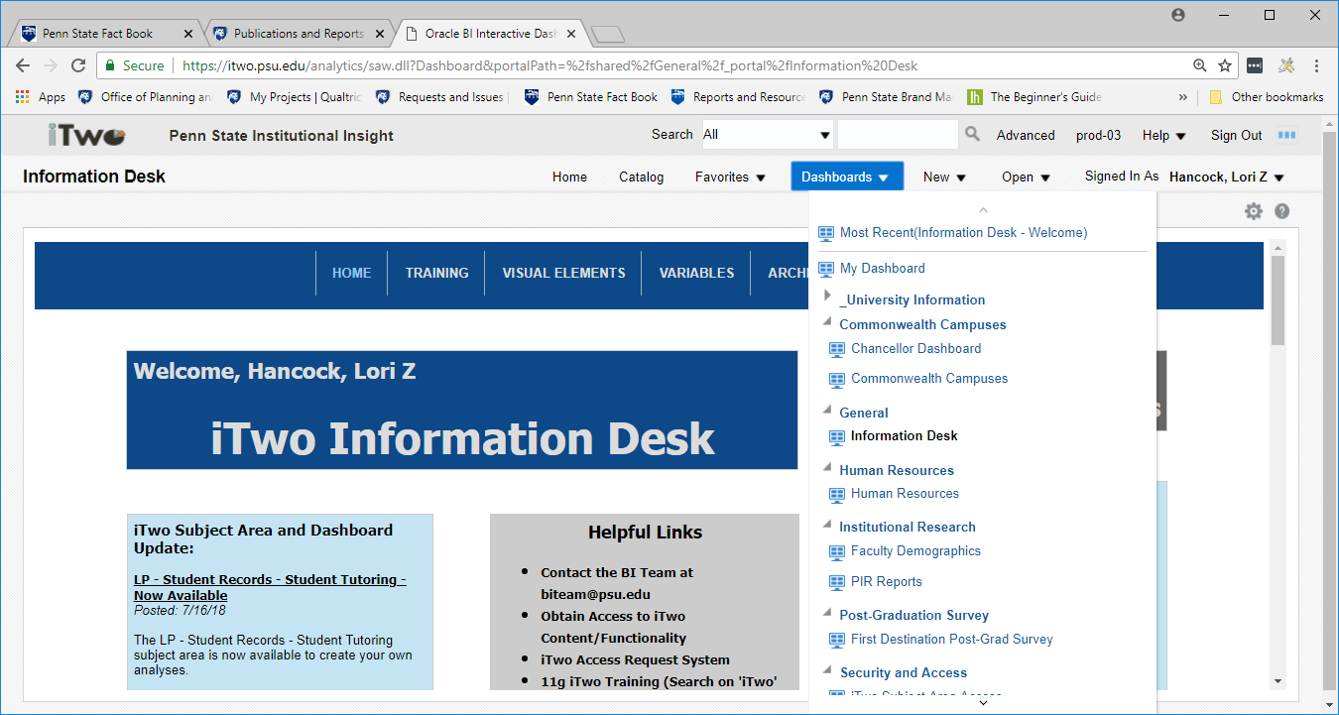
Institutional Dashboards itwo.psu.edu
Office of Planning and Assessment

Slide 6
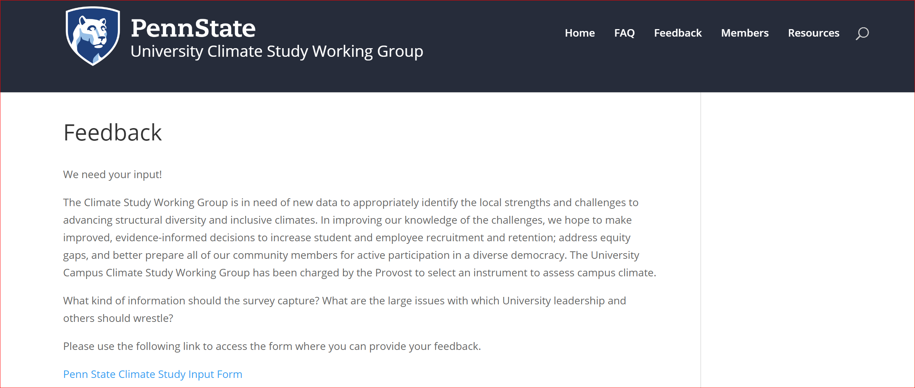
University-wide Climate Survey (Spring 2020)
sites.psu.edu/climatestudy
Office of Planning and Assessment

Slide 7
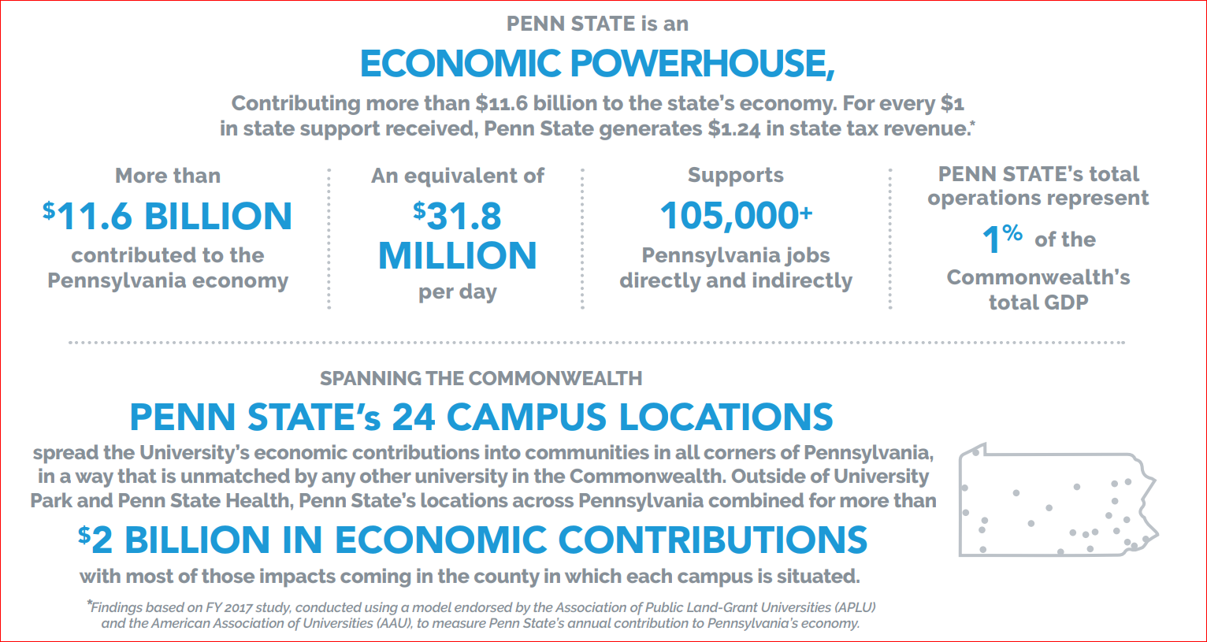
Economic Impact Studies
Office of Planning and Assessment

Slide 8
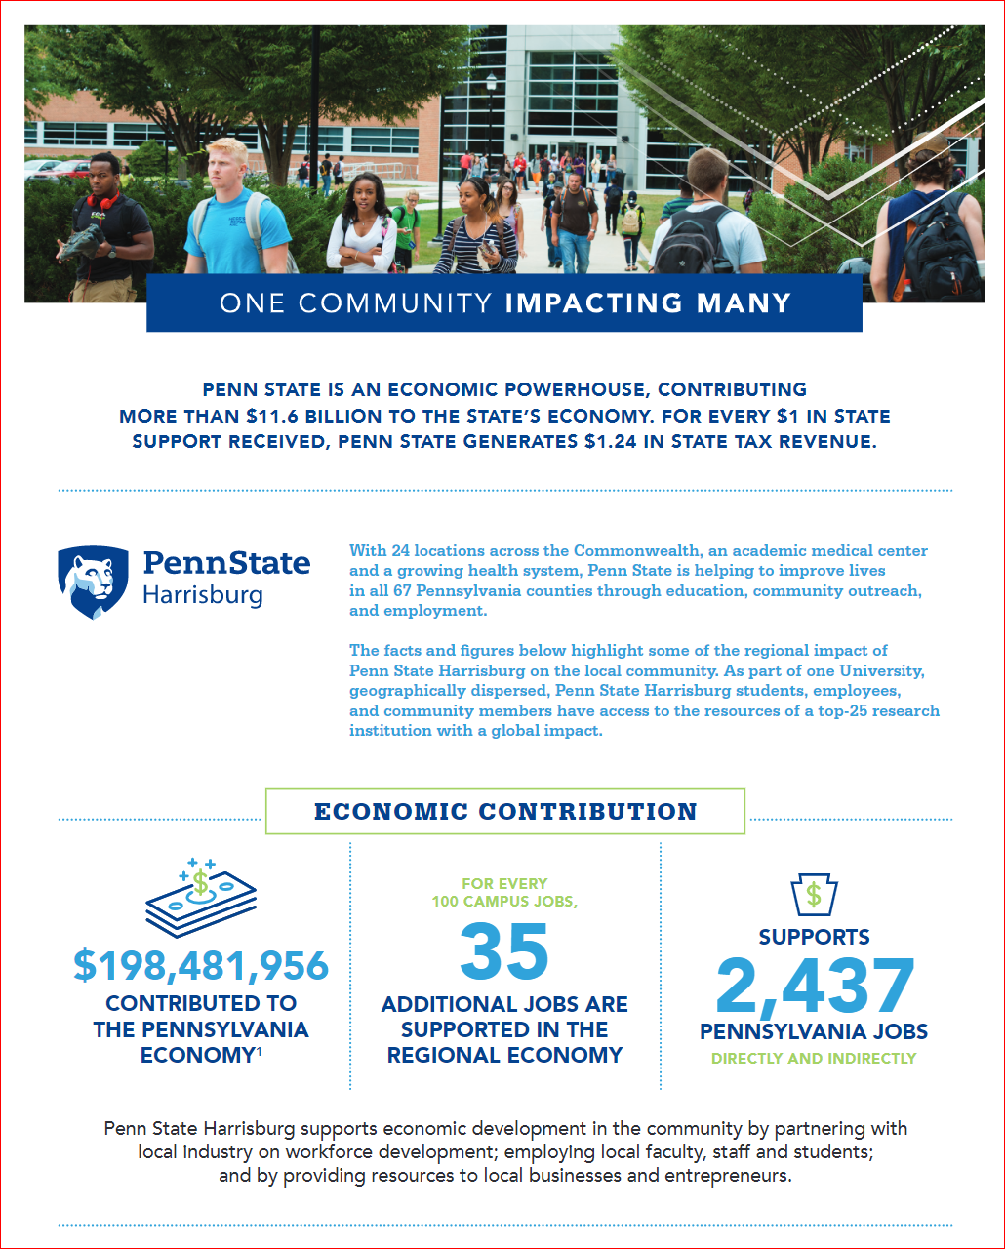
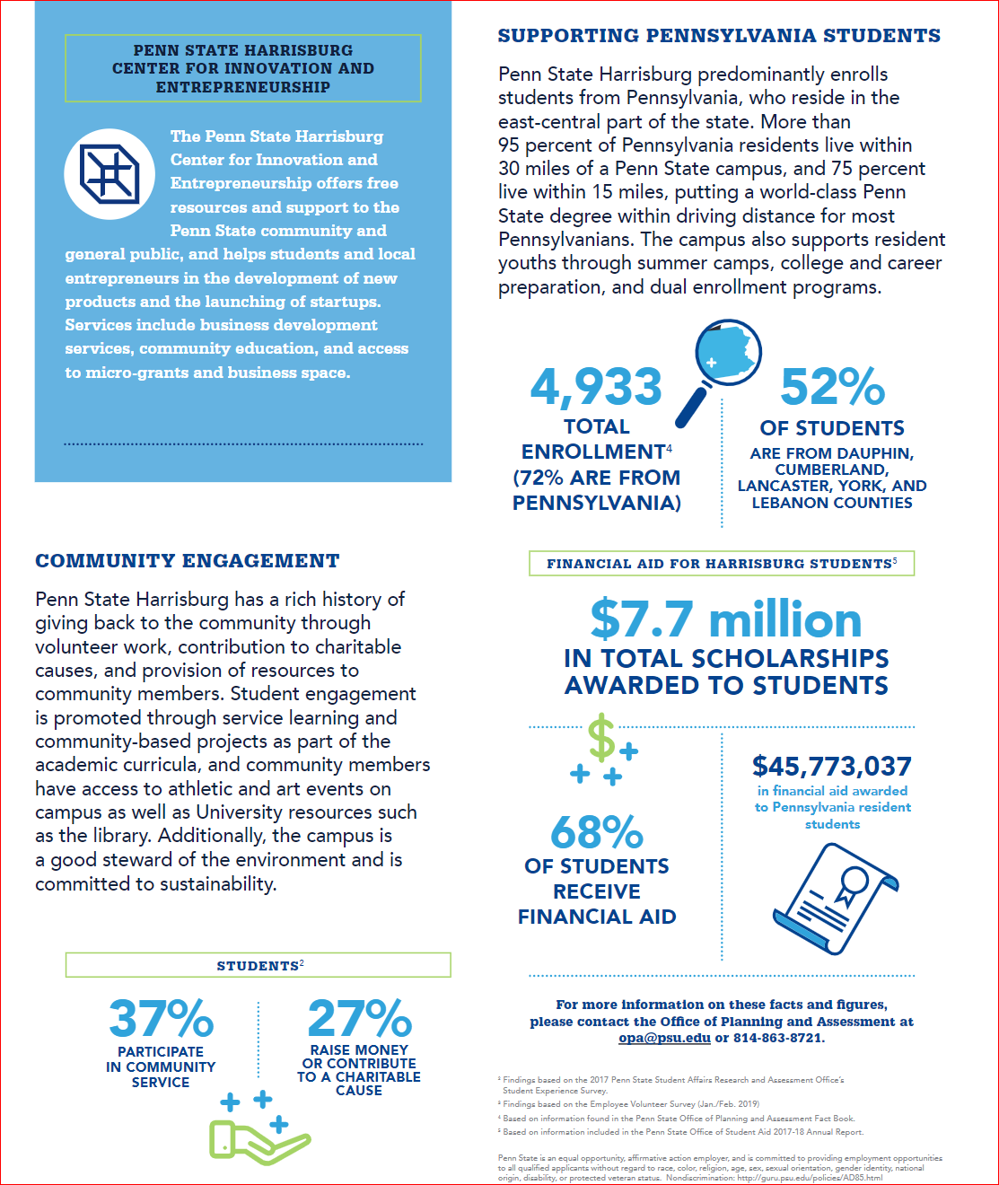
Office of Planning and Assessment

Slide 9
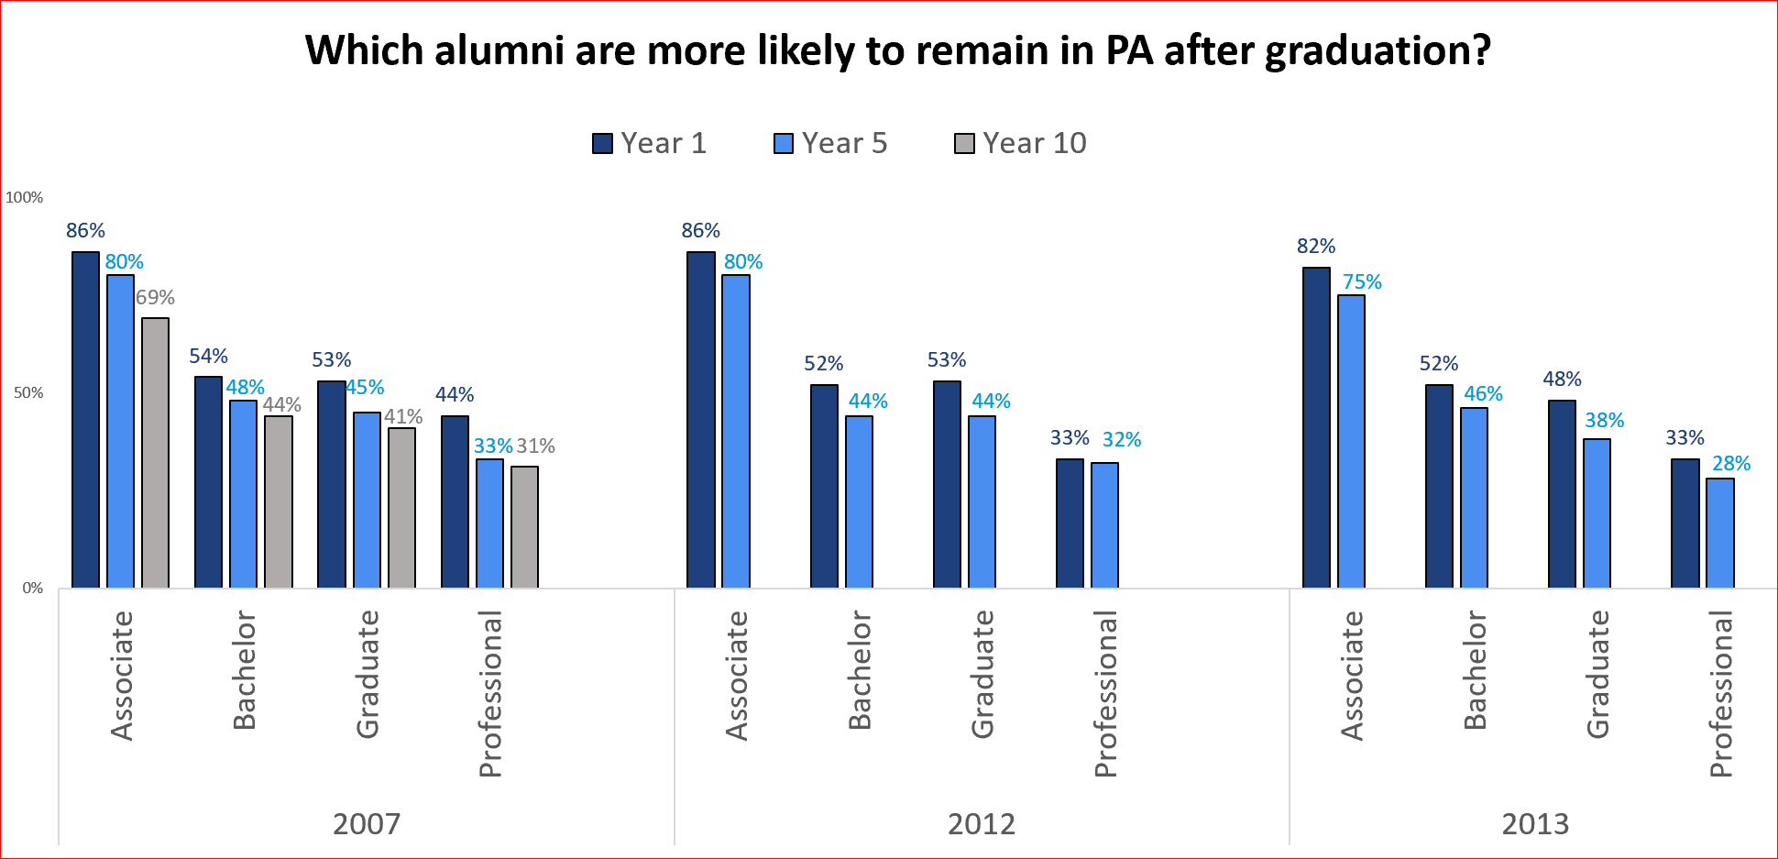
Alumni Employment and Wage Study
Office of Planning and Assessment

Slide 10
Planning
Penn State has a 30-year history of strategic planning and is considered a model in this regard
Unit plans
2014/15 – 2018/19 - Now being revised for 2020-2025
University plan
2015/16 – 2019/20 - Now extended to 2025
Implementation of the current plan is ongoing
www.strategicplan.psu.edu
Unit Plans: https://www.opa.psu.edu/plans
Office of Planning and Assessment
Notes:
Five-year strategic planning cycle since 1983
Two primary components:
Unit-Level Planning (which would include parts of units) - ideally
University-Level Planning
University-wide plan (“Our Commitment to Impact”) published in February 2016 (strategicplan.psu.edu)
Created based on 48 plans in academic and administrative units (including the campuses) in 2016. From 2020-2025, as the institutional plan has been extended, this plan will be revised based off of unit plans, signature initiatives (such as the consortium to combat substance abuse), strategic plan seed grants, and input from the various strategic plan committees.
Updates – Units are reflecting on their previous plans – figuring out where they have been, where they are, and where they would like to go. Institutional plan is being revised and iterated by the strategic plan oversight committee and will be available late fall semester to help guide unit planning.

Slide 11
Planning Suite of Services
Strategic plan support
Unit plan design and guidance
Unit mapping to institutional plan (alignment)
Unit plan implementation
RFP process
Linked to areas within the Institutional Strategic Plan
Strategic support for seed projects
Institutional Strategic Plan committee support
Oversight
Executive
Steering
Contact Daniel Newhart at dwn24@psu.edu or strategicplan@psu.edu
Office of Planning and Assessment
Notes:
Planning in your office – strategic planning
Mapping to institutional plan
Creating meaningful plans and implementation processes
Outside view to look at processes and help towards improvement
We also manage and host the RFP process
Have assisted multiple units: academic colleges, campuses, administrative units with various parts of their planning process
43 projects.

Slide 12
Learning Outcomes Assessment
Program-level assessment
Undergraduate degrees, graduate degrees and certificates
LOA liaisons: https://www.opa.psu.edu/learning-outcomes-assessment/liaisons/
Box Folders: resources, templates, examples
Assessment Management System – University-wide 2020
General Education assessment
Student survey
Direct assessment of integrative thinking
Contact Suzanne Weinstein at sweinstein@psu.edu or loa@psu.edu
Notes:
Program level assessment:

Slide 13
Learning Outcomes Assessment Timeline
June 30, 2019
Learning Outcomes Assessment Reports due annually on June 30th
Reports uploaded to Box folders currently
September 13, 2019
Spring, 2020*
College/campus visits by LOA liaisons
One-on-one meetings with program coordinators/directors of graduate studies/administrators
Group presentations
Individualized assessment report feedback from LOA staff uploaded to Box folders
Notes:
Due date for reports can be modified.
The remainder of the year we are visiting campuses/colleges, doing presentations or consultations, developing resources, planning events, assessing General Education, supporting other University-wide assessment projects, this year preparing to roll out the AMS.

Slide 14
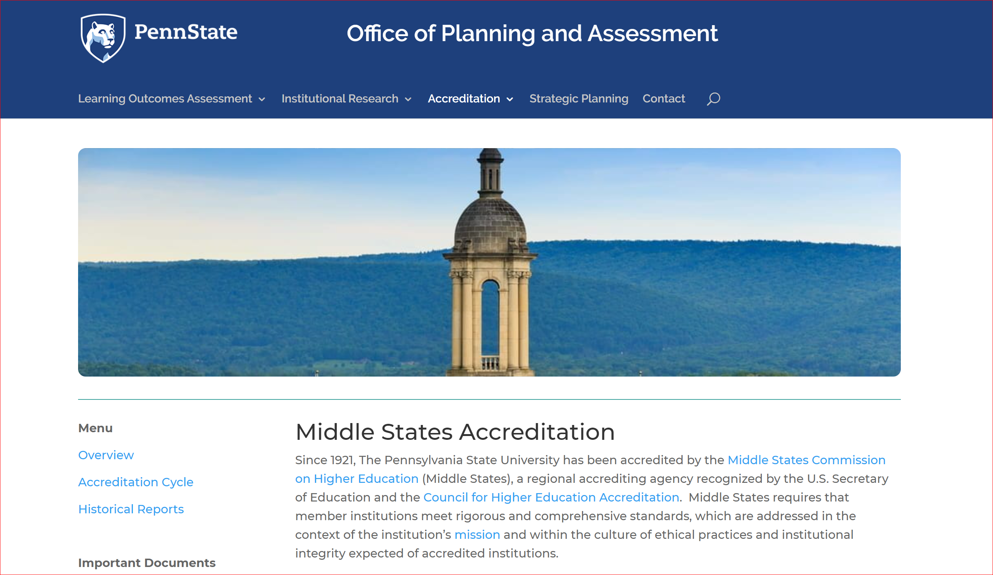
Accreditation www.opa.psu.edu/accreditation/

Slide 15
Accreditation Timeline
2022
2023-2024
2021
2020
2019
Annual Institutional Update
Annual Institutional Update
Annual Institutional Update
Midpoint Peer Review
Self Study

Slide 16
Upcoming Events
Second Annual Learning Outcomes Assessment Forum
May 12, 2020
Penn Stater Conference Center
Institutional Research Interest Group
Monthly Meetings, 2nd Friday of each month
Contact Tracy Claar (trc23) to be included in email notices with location and zoom information

Slide 17
Customized Services
Strategic institutional research studies – partnering with units on , analysis, and implications
Planning - development of plans, implementation and evaluation
Learning outcomes assessment - one-on-one consultations and customized workshops tailored to your needs

Slide 18
How can we ASSIST You?
Office of Planning and Assessment
www.opa.psu.edu
(814) 863-8721
opa@psu.edu

