Slide 1
Mentorship
Sarah Ades, Associate Dean for Student Affairs, The Graduate School
Katie Bode-Lang, Director of Education and Quality Management, Office for Research Protections
I
where
Re search
ntegrity
come together
The Office for Research Protections
Notes:
Good morning, [introduce selves].
We’re here to talk with you briefly about one your newest roles: mentor.

Slide 2

Guide
Teacher
Adviser
Safe harbor
Coach
Sponsor
Role model
Mentor
Support
Career advice
Knowledge
Challenge
Counsel
The Office for Research Protections
Notes:
Katie
As you well know, being a mentor is a multifaceted role. Being a mentor also means more than simply being an adviser. An adviser is responsible for ensuring a student fulfills departmental and institutional requirements; an adviser helps a student move through the program. As a mentor, you will certainly act as an adviser. But in working with graduate students, you’ll also be a mentor.
What does that mean?

Slide 3
Adviser
Teacher
Guide
Coach
Safe harbor
Sponsor
Mentor: a “wise and trusted counselor”
Mentor
Homer The Odyssey
Support
Role model
Knowledge
Challenge
Career advice
Counsel
Notes:
Katie
We decided to go back a ways for a succinct definition. Here is one of our favorite definitions that has stood the test of time. Homer described a mentor as a “wise and trusted” counselor.
But if you want to get a little more specific, the book “On Being a Mentor” says: Mentoring is a personal and reciprocal relationship in which a more experienced (usually older) faculty member acts as a guide, role model, teacher, and sponsor of a less experienced (usually younger) student or faculty member. A mentor provides a mentee with knowledge, advice, counsel, challenge, and support in the mentee’s pursuit of becoming a full member of a particular profession.”
You need to find a definition that works for you. And part of that is reflecting on your own experiences as a mentee. Presumably, you had your own mentor or mentors in graduate school and in your previous roles. But as we know, not everyone easily takes on the role of “wise and trusted counselor.” We’d like to take just a couple minutes reflecting on this.

Slide 4
Think about your experiences…
What is the best quality you have encountered in a mentor?
What is the worst quality you have encountered in a mentor?
The Office for Research Protections
Notes:
Katie
If you could reflect of your own experiences, think about the best quality you encountered in a mentor and the worst quality—or the quality you would’ve like to improve.
Now, we’d like you to take two minutes to share these with the person next to you. Introduce yourself, if you haven’t already, and then share with them the best and worst qualities you’ve encountered in a mentor.
[Time for two minutes]
Thanks for doing that. Now, you have two working good examples of mentorship and two examples to improve on. Let’s talk more about that… Sarah?

Slide 5
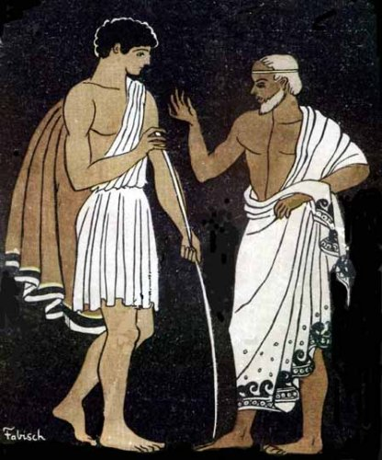

What does a mentor look like?
REX/Shutterstock
Pablo E. Fabisch
Notes:
Sarah
Being a mentor is not something most of us were trained to do. One default is to be the kind mentor your mentor was. You do not and I'd go so far as to say you should not do this. Take the good parts from your mentors and incorporate them into your own mentoring style, leave the bad parts behind, including the toga.
Another default path is to view mentoring as creating mini-mes, miniture versions of yourself. This is not the best approach either. Your mentees will be independent people with different worldviews than you – guide them as they shape themselves.
So what should you do to become a good mentor? Here are what we think are key points to keep in mind as you develop your mentoring style.
I encourage you to spend some time to think purposefully about mentoring. It is an important skill to learn.

Slide 6
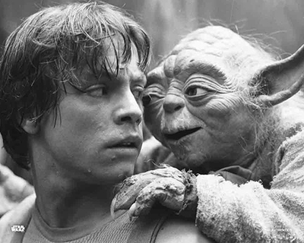
Advice for New Mentors
Listen
Be a role model
Consider mentee’s best interests
Set clear expectations
Be respectful
Give mentees room to fail
Be adaptable
Communicate
www.starwarsauthentics.com
Notes:
Sarah
Listen- have you ever had the experience of trying to get advice from someone only to have them talk on and on about their experience and not pay attention to what you were trying to ask?
Be a role model- there is a power differential between you and a mentee, they look up to you and take your actions as a model. For those of you coming directly from grad school or a postdoc, this is a new experience and does carry responsibility
Best interests – remember 2 things mentee is not you and is at a very different place in their career
Set expectations – Do not assume that beginning students know what is expected of them. these can be high expectations but make them clear, good to even put them in writing.
Be respectful – this goes without saying
Room to fail – there is an inherent conflict because often your success will be tied up in how well your grad students perform. However remember they are learning and will make mistakes, and goal is they will learn from the mistakes
Be adaptable – different mentoring relationships with and ways to motivate different students, mentoring relationships will change over time as students grow and develop
Communicate – Back to the opening point. You drive the relationship and may need to draw out a student. Also remember that students may not grasp/remember everything you tell them. Give them feedback.

Slide 7
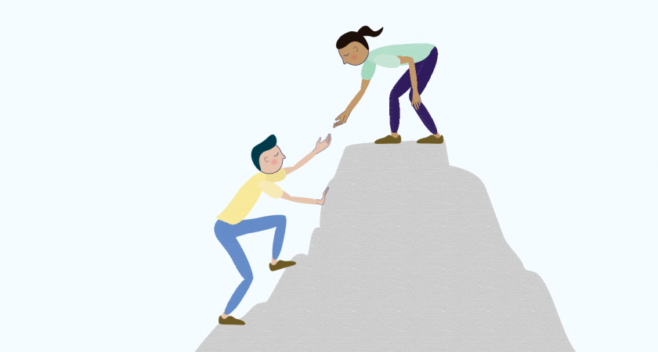
You also need a mentor
use formal mentoring programs
seek mentors on your own
multiple mentors for the multiple aspects of your career
https://dslx.mit.edu/resources/mentoring-101
Notes:
Sarah
Remember also that mentoring is a career-spanning process.
Look for mentors for yourself to help you negotiate being a faculty member.
- your dept may have a formal mentoring system
- even so, keep an eye out for people whose work and ways of interacting at the university you admire, seek advice from them, also seek advice from people outside of the university from your disciplinary community
- you are in no way locked into having one mentor.

Slide 8
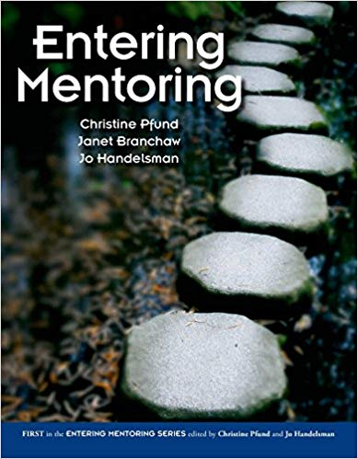
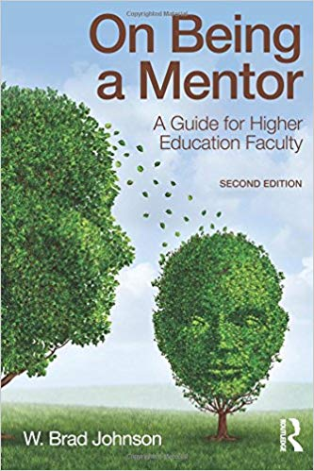
Mentoring Resources
Grad School: Recommended Practices
Other online resources
Office for Research Protections: Compliance and Research Ethics
University, College, Departmental Policies
PSU Offices
CAPS, Student Affairs, Student Disability Resources
Notes:
Katie: Which brings us to resources. You don’t need to go this alone! We’ve put together a list of resources for you, which is available on the Vice Provost’s website along with today’s slides. We highly recommend reviewing a book on mentoring for some good hints and tips.
Sarah: The Graduate School has Recommended Practices online and other resources.
Katie: I also want to make sure you know about the Office for Research Protections—we’re happy to partner with you as your working with your students on an IRB protocol or another compliance issue. You don’t need to design a project to avoid our office (yes, we know it happens!). Talk to us first so we can help you potentially minimize the compliance issues. We can also come to your lab to give a presentation if you need it. We don’t teach research design, but we can help with compliance. My office also manage issues of research misconduct, so it’s really to our advantage when our graduate students have engaged mentors. Without going into detail, I think it’s important to know that the University had to revoke three graduate degrees over the last two years for issues of research misconduct, and nobody wants that to happen. Your students depend on you for guidance on all issues—don’t be afraid to get help where you need it.
You’ll also want to familiarize yourself with your own department’s policies, along with University policies, so you make sure you’re helping with the advising portion of your job.
Sarah: In the same turn, there are offices on campus devoted to helping students in distress, from CAPS (the counseling center) to Student Affairs. Again, these are all on the resources sheet on the website.

Slide 9
Mentoring Workshops coming soon!
Notes:
Sarah
We’re looking to actively support you in your mentoring journey, and Sarah’s office with Kathy Bieschke's office is working on some mentoring workshops. Stay tuned to the Graduate School for more information this fall.
We wish you much luck as you begin your work here at Penn State, and we hope you’ll reach out to us if you need us!

