Slide 1

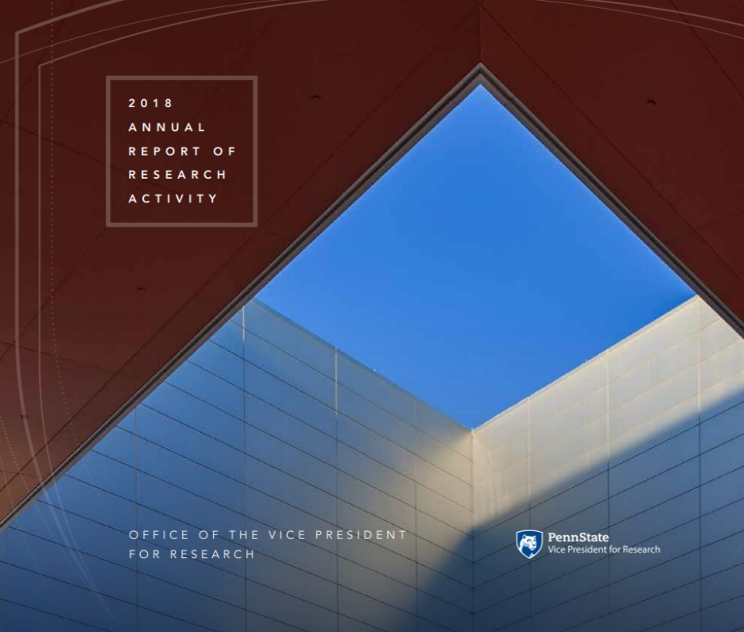
Neil A. Sharkey
NEW FACULTY ORIENTATION
August 20, 2019

Slide 2
EDUCATION
Penn State’s Land Grant Mission
RESEARCH
OUTREACH
Notes:
2
Penn State has a tripartite mission of teaching, research and service. These missions are integrated, each to the other.

Slide 3
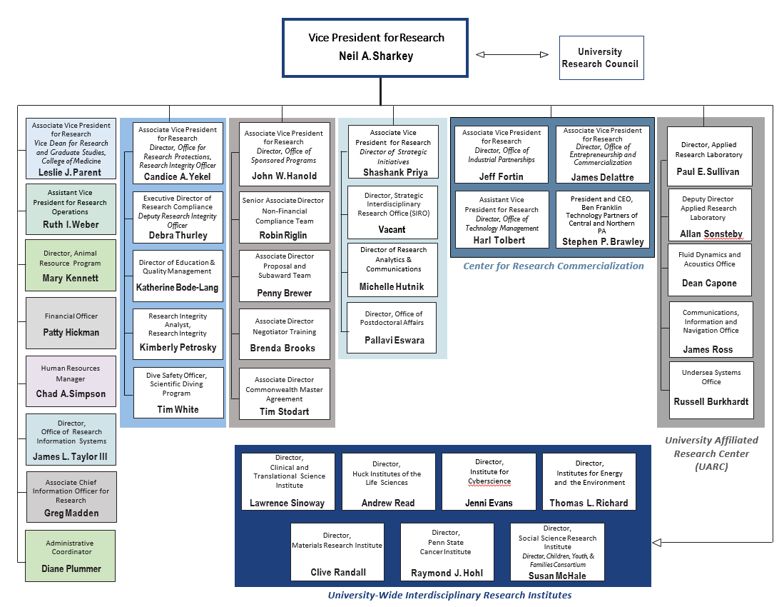
OVPR Organizational Chart

Slide 4
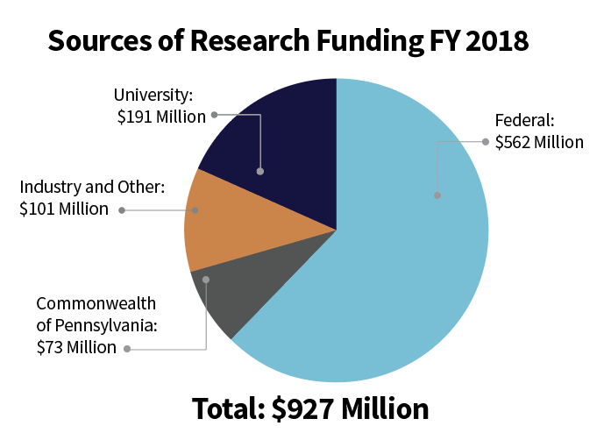
Research Expenditures
Total Research Expenditures FY 2018
Total: $927 Million
Dollars
1931
2018

Slide 5
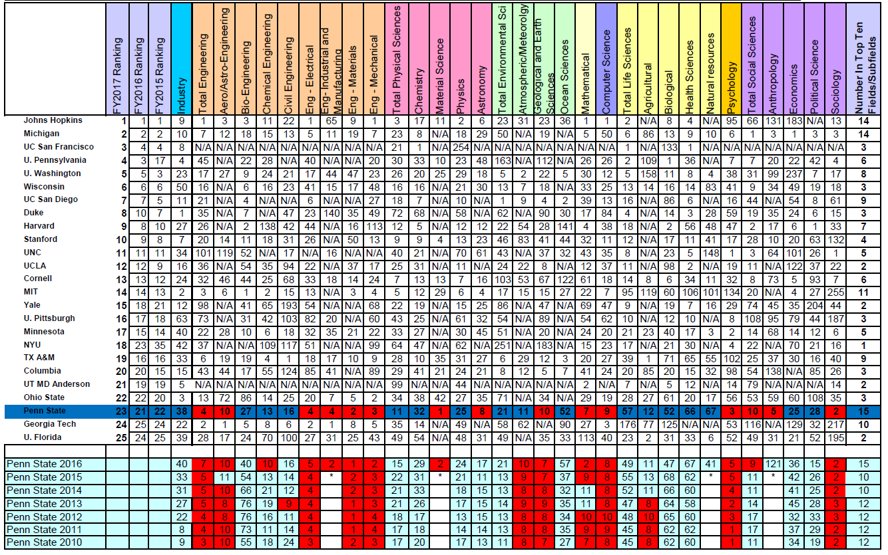
NSF Rankings for FY 2017
Top 25 by Fields and Subfields

Slide 6
The Mission of the OVPR Institutes
Community of Colleagues
    Seminars
    Workshops
    Team Building for Research Initiatives
Co-Funded Appointments
Core Facilities
Seed Funds for Scholarship/Research
Notes:
6

Slide 7
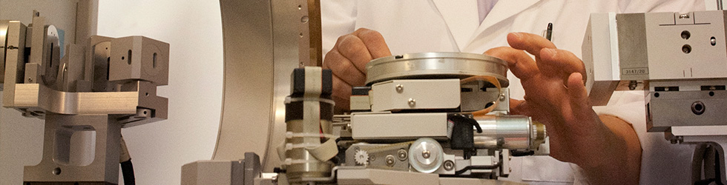


Materials Research Institute
www.mri.psu.edu
Notes:
7
The Materials Research Institute, directed by Dr. Carlo Pantano, represents one of the oldest and well established of our institutes. There are many core facilities including the materials characterization laboratory and nanofabrication facility available for the use of our faculty and students.

Slide 8
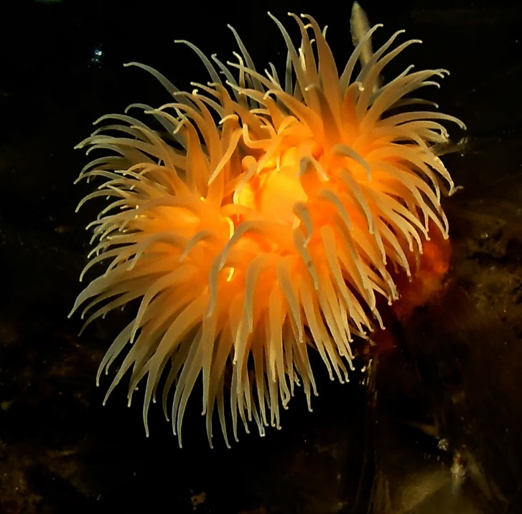
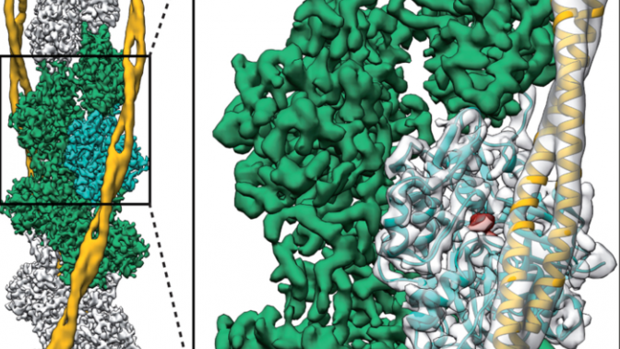
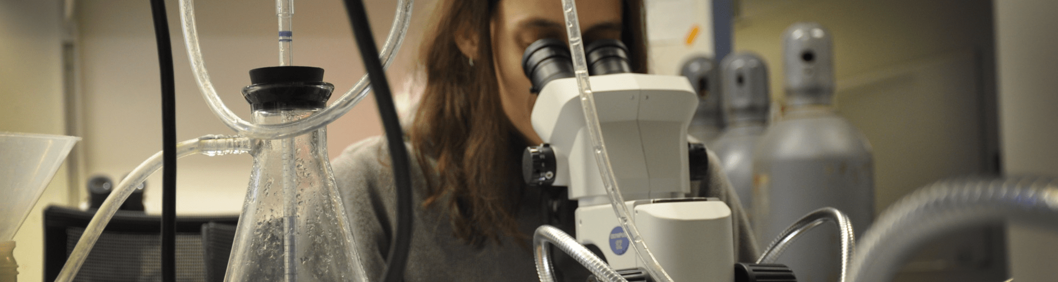
Huck Institutes of the Life Sciences
www.huck.psu.edu
Notes:
8
The Huck Institutes of the Life Sciences, directed by Dr. Peter Hudson, supports activities that span colleges and campuses with active participation from the College of Medicine. Fields of interest are widely dispersed from infectious diseases to plant biology. In addition the Huck Institutes are home to many core facilities that may be useful to some of you.

Slide 9
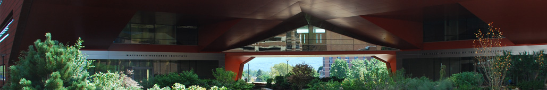
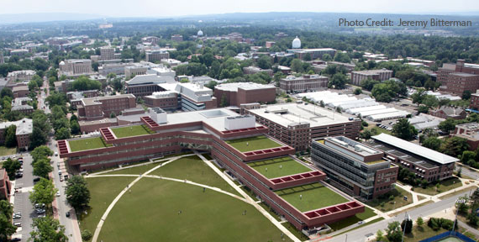
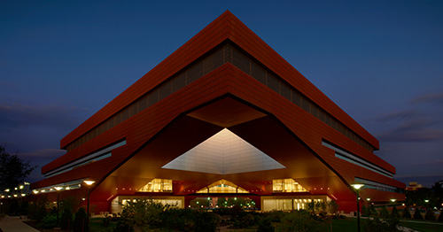
The Millennium Science Complex

Slide 10

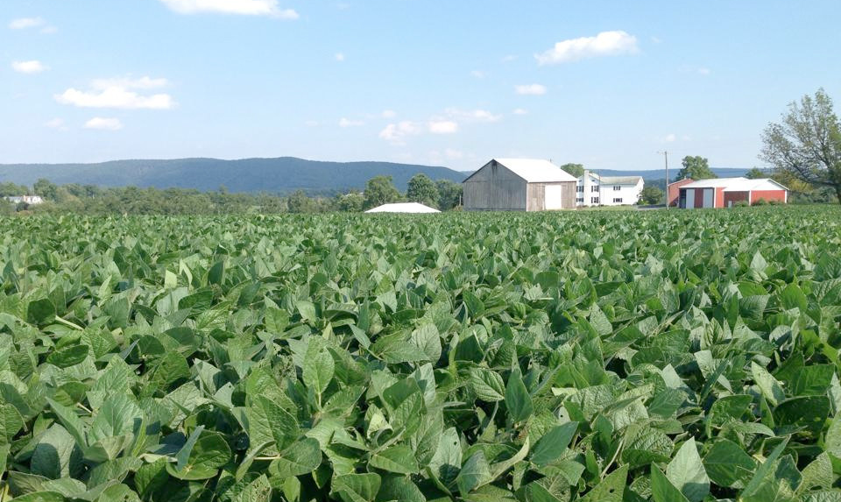
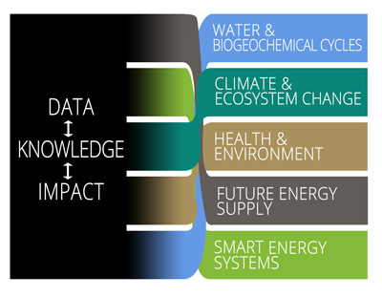
Institutes of Energy and the Environment
www.iee.psu.edu
Notes:
10
10
Penn State Institutes of Energy and the Environment, directed by Dr. Tom Richard, embraces long term collaborations related to environmental issues and has recently initiated a major effort to further grow and enhance the vibrate energy research initiatives across campus.

Slide 11

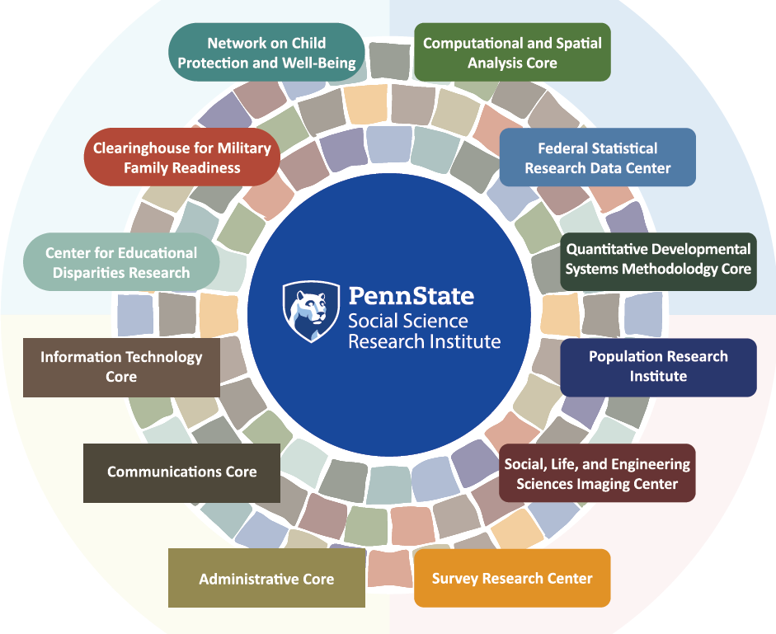

Social Science Research Institute
www.ssri.psu.edu
Notes:
11
The Social Science Research Institute, directed by Dr. Susan McHale, is home to the children, Youth and Families Consortium, the Population Research Institute and the Survey Research Center. The latter may be of use to many of you.

Slide 12

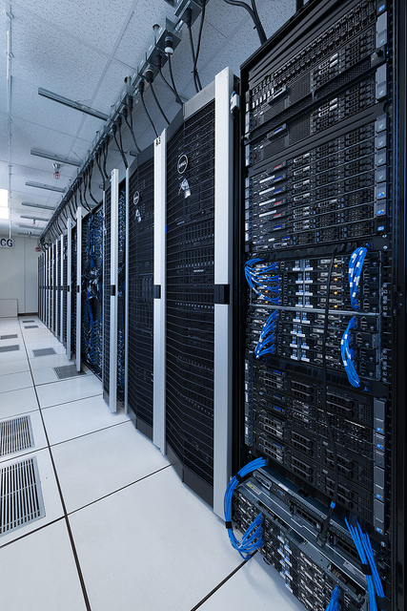

Institute for CyberScience
An expansion to our HPC architecture in 2019 will help cement Penn State’s position as a leader in HPC-enabled research, opening doors for new partnerships.
https://ics.psu.edu
Notes:
12
ICS is a new institute that is actually a net over the other institutes. Dr. Padma Raghavan, its director, is aggressively pursuing opportunities that bring cyberscience to faculty as a tool to solve complex problems, and as a sophisticated discipline in its own right.

Slide 13



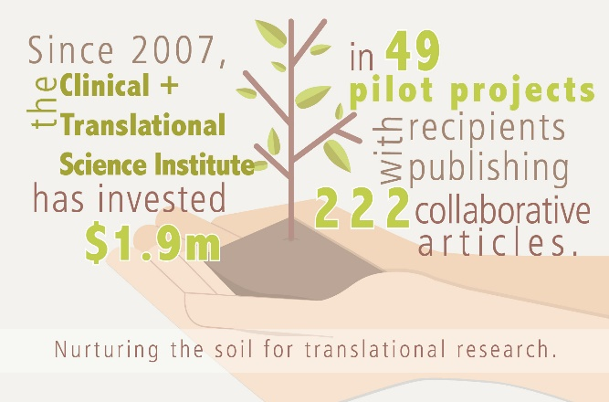

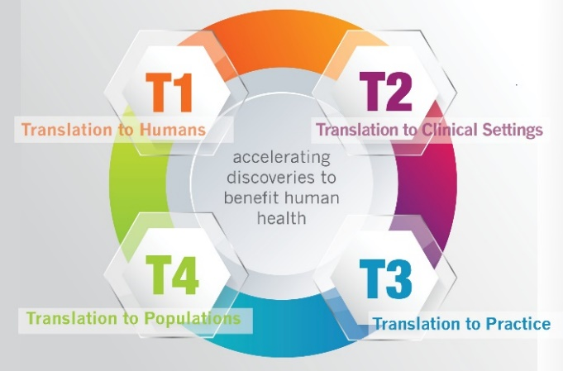
Clinical & Translational
Science Institute
http://ctsi.psu.edu
Notes:
13
13
Penn State is among the best Universities nationally in terms of an environment in which to conduct interdisciplinary research. We have very few barriers. Six major cross campus initiatives are run through the research office. I will just introduce you to each of these now. In your packets you will find a web site URL and brief description of each Institute. The Institutes of the Arts and Humanities is directed by Dr. Marica Tacconi. The institute supports special initiatives for our creative faculty, promoting in particular interesting interdisciplinary initiatives.

Slide 14

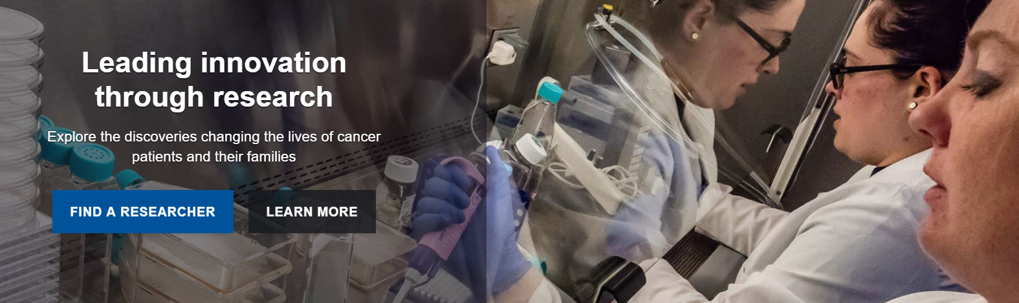

Penn State Cancer Institute
https://cancer.psu.edu

Slide 15

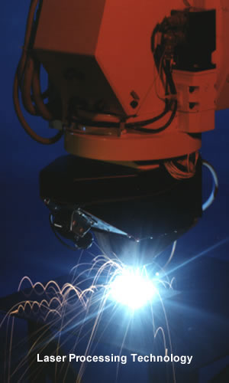
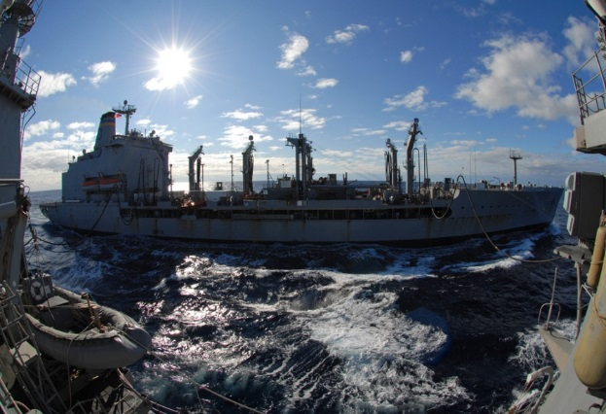
Defense-Related Research
Applied Research Laboratory
  Autonomous Control & Intelligence Systems
  Systems Engineering & Analysis
  Energy Sciences & Power Systems
  Acoustics
  Fiber Optics
  Laser
  Materials, Design, & Process
  Night Vision & Infrared
Education
www.arl.psu.edu
Notes:
15
Explain that DOD is one of the biggest sponsors for research at PSU because we have this special navy sponsored laboratory. The laboratory is an important place for students to gain experience, both undergraduate and graduate students. It is also a rich source of colleagues for collaborations.

Slide 16
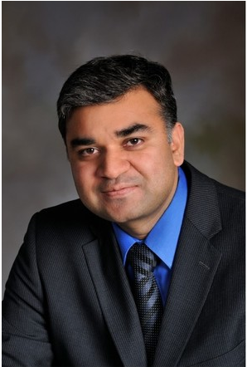



Strategic Initiatives
Shashank Priya
Associate Vice President for Research,
Director of Strategic Initiatives
https://www.research.psu.edu/node/3012
https://www.research.psu.edu/siro
https://research.psu.edu/limitedsubs

Slide 17
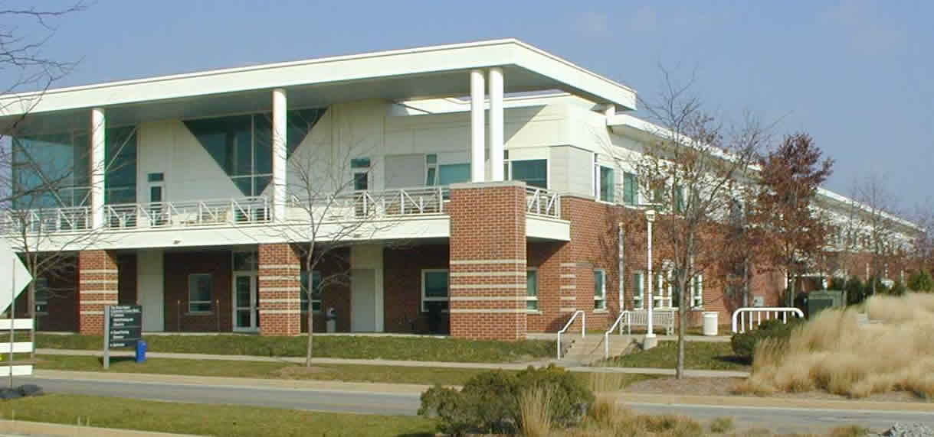
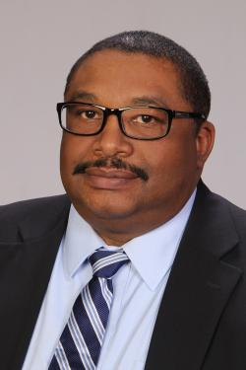
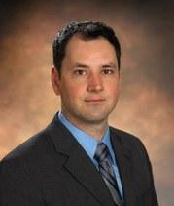
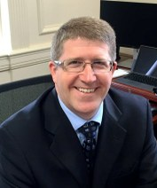
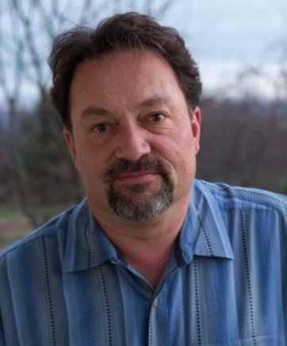
Technology & Commercialization Center
Office of Technology Management
www.research.psu.edu/otm
Office of Entrepreneurship and Commercialization
https://invent.psu.edu/
Office of Industrial Partnerships
https://researchpartnerships.psu.edu
Ben Franklin Technology Partners
https://cnp.benfranklin.org/
Harl Tolbert
Assistant Vice President
for Research
Director, Office of Technology Management
James Delattre
Assistant Vice President
for Research
Director, Office of Entrepreneurship and Commercialization
Jeff Fortin
Associate Vice President
for Research
Director, Office of Industrial Partnerships
Steve Brawley
President/CEO
Ben Franklin Technology Partners of Central and Northern PA
Notes:
17
Tech transfer is housed at Innovation Park on the first floor of the Technology Center.

Slide 18
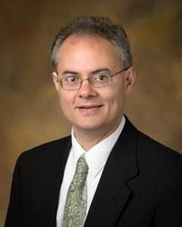
Office of Sponsored Programs
John Hanold
Associate Vice President for Research
Director, Office of Sponsored Programs
www.research.psu.edu/osp
Notes:
18

Slide 19
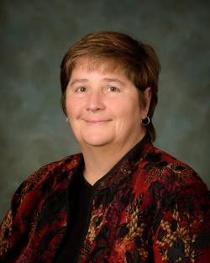
Office for Research Protections (ORP)
www.research.psu.edu/orp
Human Research Protection Program (IRB)
Animal, Biosafety, and Isotope Research Protection Program (IACUC, IBC, UIC)
Scientific Diving Program
Unmanned Aircraft Program
Dual Use Research of Concern
Human Embryonic Stem Cells
Conflict of Interest Program
Education & Quality Management
Research Misconduct Inquiries & Investigations
Candice Yekel
Associate Vice President for Research
Director, Office for Research Protections
Notes:
19
We are guided by federal law and those of you who work with human subjects, animals etc. will be required to secure appropriate approvals. I am sure most of you are already familiar with IRBs, IACUC committees etc. if you work in these domains. I want to emphasize your role as “examples” for your students. None of us is born with a genetic code telling us what is proper research behavior, and what types of habits will be best to insure our behavior is good. I ask that you engage in regular conversations with your faculty and with your students about the issue surrounding research practices; everything from authorship, how it is determined and what is proper, to proper citation practices, notebook maintenance etc. Every year my office see cases of misconduct. The cases we adjudicate are usually faculty cases, but these people were once students. The habits we promote will last a life time; lets insure they are good habits.

Slide 20
Office for Research Protections (ORP)
research.psu.edu/education
Educational Program
  Scholarship and Research Integrity (SARI@PSU) = training in the responsible conduct of research
      Required for faculty: Any CITI online training OR two hours of discussion-based activities, plus one hour continuing education every 3 years
  Campus-Wide Workshops
  Compliance system training
  (IRB, IACUC)
Notes:
20
To assist you we have developed a series of education tools. Beginning in fall 2009 and will be requiring that all graduate students be exposed to responsible conduct of research education, but we all know “Education begins at home.” And as I have already said as the mentors and role models, you are the ones who really reinforce these messages.

Slide 21
Office for Research Protections (ORP)
www.research.psu.edu/education
ORP required education and training:
Offered online through the Collaborative Institutional Training Initiative (CITI):
  IRB training (for research involving human subjects)
  IACUC training (for research and other activities involving vertebrate animals)
  Biosafety training (for research and other activities involving biohazardous materials and/or bloodborne pathogens)
SARI@PSU education for all new faculty
  RCR, GCP, GLP, DURC (based on research)
Notes:
21
To assist you we have developed a series of education tools. Beginning in fall 2009 and will be requiring that all graduate students be exposed to responsible conduct of research education, but we all know “Education begins at home.” And as I have already said as the mentors and role models, you are the ones who really reinforce these messages.
In 2011, SARI@PSU was expanded to include new faulty, postdoctoral fellows, and undergraduate researchers.

Slide 22
Significant Financial Interests (“SFI”)
Investigators are required to disclose personal financial interests that are related to his/her institutional responsibilities
Disclosure triggers: upon hire*, at least annually, within 30 days of discovering or acquiring a new SFI, and prior to the submission of research proposals that are related to the SFI
If the COI Committee determines a potential or perceived conflict between the disclosed SFI and Penn State research, it will work with the investigator to reduce or eliminate the conflict See: RP06 (https://guru.psu.edu/policies/RP06.html)
*New faculty will receive an email re: disclosure this fall
Notes:
22
Conflict of interest is a problem of life. It cannot also be avoided but can usually be managed. The university encourages faculty to develop intellectual property and as such COI will happen. But if you disclose up front, talk with your department head, plans can be develop that do not prevent you from being involved in such activities. Similarly consulting is permitted but we all must remember that our primary commitment is to the University and its students. Consulting can be a very good thing; it helps with economic development, sharpens our skills, creates contacts that can help research and help our students; it is not a bad thing but must be handled well.

Slide 23
Disclosing International Collaborations
The U.S. government is working hard to ensure that federally funded researchers accurately disclose their relationships and activities with foreign institutions and funding agencies.
Penn State researchers must disclose all applicable “Other Support” as required by federal sponsors.
  Examples include (but are not limited to): participation in foreign talent programs, work completed at a non-U.S. site, research conducted with support from a non-U.S. award, consulting or business activities outside the U.S.
  Researchers should also promptly report inventions or intellectual property to the Office of Technology Management: https://www.research.psu.edu/otm/inventors
The OVPR website details the steps you can take to protect yourself and your research. New guidance and clarifications are being issued on a rolling basis; agency-specific updates are sent to research administrators, those with active grants and are posted here:
https://www.research.psu.edu/international_affiliations
Notes:
Faculty are encouraged to engage in outside activities when such activities enhance the mission of the University and do not compete with the University.

Slide 24
Outside Professional Commitments
Outside business activities cannot exceed 40 hours per month.
Special care should be exercised in executing private consulting contracts or arrangements. For example:
  contracts should be examined to ensure that the assignment of rights to intellectual property evolving from consulting activities does not conflict with the patent agreement signed by all faculty; and
  any associated compensation will likely require a financial disclosure by the faculty involved
See: AC80 (https://policy.psu.edu/policies/ac80)
AD77 (https://policy.psu.edu/policies/ad77)
RP06 (https://policy.psu.edu/policies/rp06)
Notes:
Faculty are encouraged to engage in outside activities when such activities enhance the mission of the University and do not compete with the University.

Slide 25
Data Management and Integrity
Researchers are responsible for:
Ensuring the integrity of their data
  RP02 (https://policy.psu.edu/policies/rp02)
  Ensuring that the data from published papers are publically accessible
    http://datacommons.psu.edu/
Properly archiving data
    AD22 – Health Insurance Portability and Accountability Act (HIPAA)
    AD35 – University Archives and Records Management
    AD53 – Privacy Policy
    AD95 – Information Assurance and IT Security
    AD96 – Acceptable Use of University Information Resources

Slide 26
Matching Funds Policy
Equipment (if required by sponsor):
  Match of 15% from central on minimum annual equipment cost of $100,000
  College/department must match at a minimum of 7.5%
          https://policy.psu.edu/policies/rag51
Graduate Assistantships/Traineeships (GA):
  Match equal to 50% of F&A generated on GA costs or 10% of total GA costs
  Minimum annual match of $10,000
  https://policy.psu.edu/policies/rag52
Notes:
26
I see we don’t have the urls listed here.

Slide 27
Researcher Resources www.research.psu.edu
Find Research
  A searchable database of Penn State researchers and papers:
  http://pure.psu.edu
Find Computing/Data Resources
  A searchable database of networking tools, services, cyberinfrastructure, data sources and more.
  http://researchdata.psu.edu
Find Funding
  Links to internal and external funding resources
  http://funding.psu.edu
Find Instrumentation
  Penn State’s shared core facilities
  http://capabilities.psu.edu

Slide 28
myResearch Portal www.myresearch.psu.edu
Provides investigators an integrated view of sponsored portfolio data
Simple tools to support the PI
  Current and Pending report
  Export financial data to Excel
Accessible anytime, anywhere
Simple to use, always evolving
Login with two-factor authentication

Slide 29
WELCOME!
We are here to support
your efforts!
www.research.psu.edu
Notes:
29
This is a reference to our office in general and an introduction to OSP

Slide 30
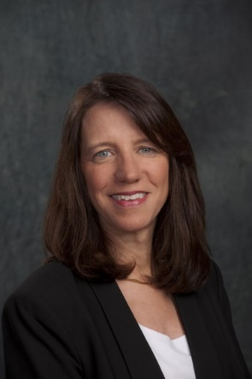
WELCOME!
We are here to support
your efforts!
Also joining us here today, is, Dr. Lora G. Weiss, interim senior vice president at
Georgia Institute of Technology, and interim director of the Georgia Tech Research Institute;
and Regents’ Researcher,
University System of Georgia.
She will begin her tenure as senior vice president for research at Penn State on September 16.
www.research.psu.edu
Notes:
30
This is a reference to our office in general and an introduction to OSP

