Slide 1

Living our Land-Grant Mission
New Faculty Orientation
August 20, 2019

Slide 2
What Does it Mean to be a Modern Land-Grant University?
The Commonwealth Campuses
Research
Community Engagement
One Penn State 2025

Slide 3
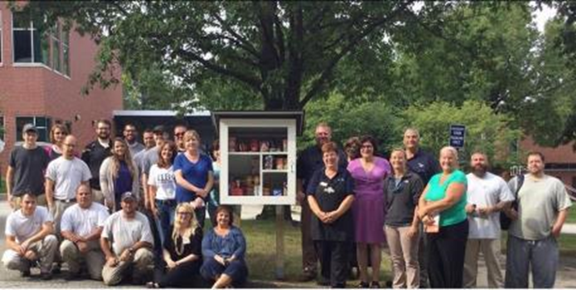
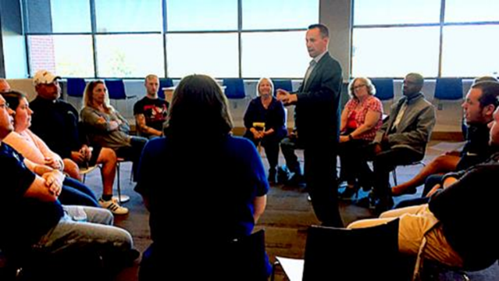
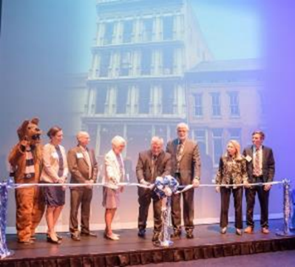
The Commonwealth Campuses

Slide 4
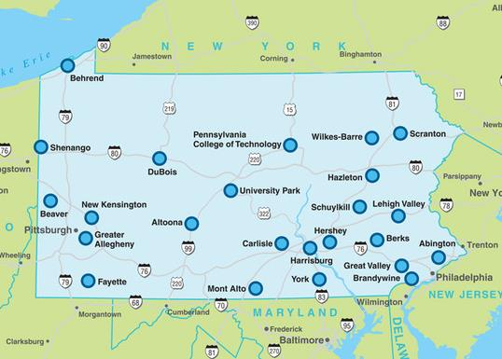
One University, 20 Undergraduate Campuses
One mission
One administration (academic leadership, business and finance operations, student affairs, research enterprise, and physical plant)
One application for admission/Admissions Office
One governing board

Slide 5
The Value of our Structure
Integration across the state provides stability
Affordable access to a world-class degree
Pipeline for diversity
Economic impact to communities
Philanthropy tied to campuses

Slide 6
Integration Provides Stability
Strength in numbers
Provides access to more PA residents
  50% of all first-year students (60% of PA students) start at a CC; Nearly 4,000 student transitions annually—3,600 to UP
Serves rural, suburban and urban populations
Allows for regionalization (e.g. nursing and health-related entrepreneurship at Berks given proximity to Penn State Health St. Joseph)

Slide 7
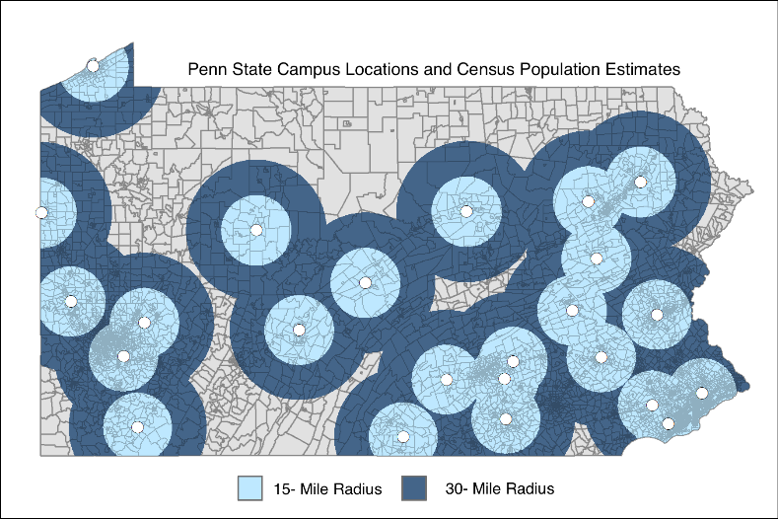
Providing Access to More PA Residents
75.2% of PA residents live within a 15-mile radius of a campus
95.6% of PA residents live within a 30-mile radius of a campus

Slide 8
Serving Families of Modest Means

Slide 9
Pipeline for Diversity
Diversity is essential–for business model, moral imperative and environmental richness.
CC reflect diverse population in their catchment areas: UP is an exception (a broad catchment).
  Birth rates declining in most PA counties (Avg. -4.3%); but increasing in urban areas in PA and nationally.
CC students help build diversity at UP when they transition with the 2+2 model.

Slide 10
Economic Impact to Communities
Penn State contributes $11.6 billion to PA economy; supports 105,000 jobs across PA.
Invent Penn State: 21 LaunchBoxes– 1,800 entrepreneurs assisted; 5,000 students, faculty and staffed engaged; 200+ new products and companies; $4.5M in external/leveraged funds
Campuses are cultural centers; a magnet for communities.

Slide 11
Philanthropy/Volunteers Tied to Campuses
Individuals and businesses connected to Penn State through campuses.
PSAA: 21 Campus Societies and 200+ alumni volunteers serving more than 468,000 alumni who attended a CC.
20 CC Advisory Boards with 610 Board Members.
294 CC Campaign Committee Members.
Local industries provide 3,500 internships annually.

Slide 12
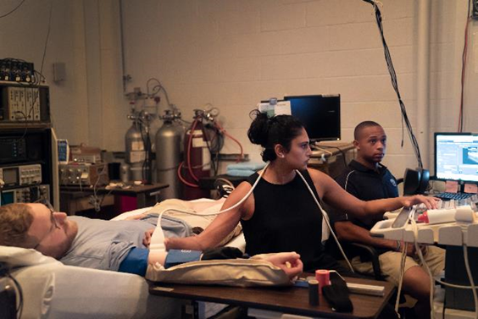

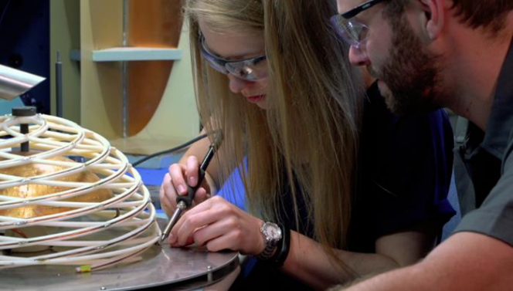
Research

Slide 13
Intersection of Teaching and Research
  Over the last 5 years, nearly 8,000 students completed an undergraduate research experience for academic credit; many
  more conduct research without earning credits.
  60.5% of individuals supported by federal and non-federal research funding in FY2016-17 were students.
  156 Erickson Discovery Grants ($3,500 each) were awarded in 2017-18 to students on 11 campuses.
  External grants and contracts provided $24.7M in grad student support in FY2017-18.

Slide 14
Signs of Research Excellence
8 years of research expenditures of $800+M; $927M in 2017-2018.
15 disciplines rank in the top 10 of NSF Total Science and Engineering Research Expenditures; Penn State ranks 23rd overall.
One of only 2 institutions in the U.S. accorded land grant, sea grant,
sun grant, and space grant status.
University Libraries rank 10th among North American research libraries.
No. 7 among top producers of U.S. Fulbright scholars and students.
110+ faculty members in the National Academies: Engineering, Science, and Medicine; American Academy of Arts and Sciences; and American Association for the Advancement of Science.

Slide 15
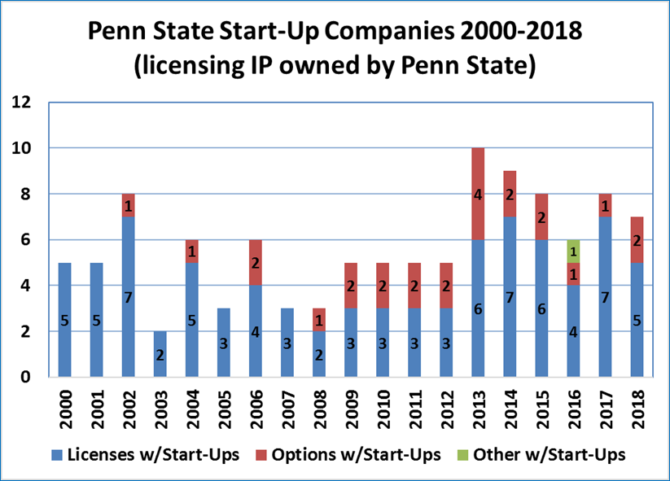
Tech Transfer
Penn State attracts research partners from the private sector with one of the nation’s friendliest IP policies for industry sponsored research.

Slide 16
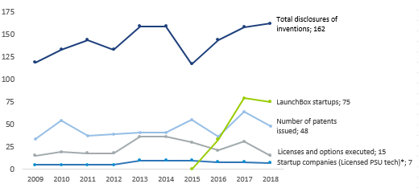
Number of Disclosures, Patents, Licenses and Startups

Slide 17














Top Corporate Collaborators
340 corporate partners from 2013-18; 1,711 co-authored publications.
On average, 500 companies sponsor projects every year with approximately 1/4 of those being PA companies.

Slide 18
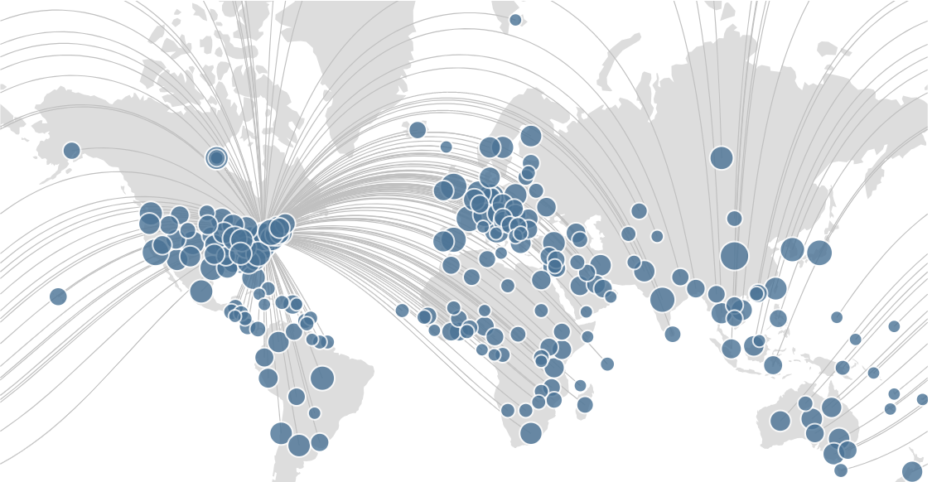
Global Research Collaborations (past 5 years)
Source: Pure.psu.edu

Slide 19
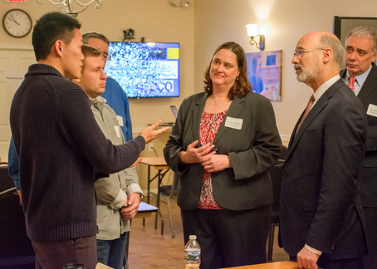

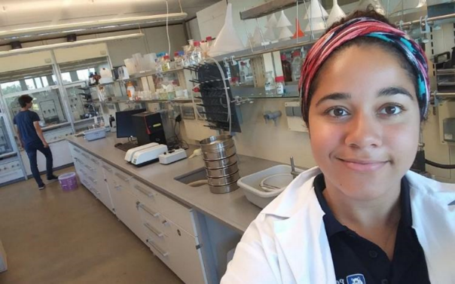
Community Engagement

Slide 20
Scope of Penn State’s Engagement Effort
Areas of Impact: Agriculture; Business, Finance & Industry; Children, Youth & Families; Clinical Services (health and medicine); Community Design & Development; Economic Development including Tech Transfer; Energy & Shale; Environment, Sustainability & Water; Government; Health, Wellness & Human Development; Justice & Safety; and K-12 Education.
Funded by: Federal Agencies; Commonwealth Appropriations; County Funding; Fee-for-Service & Contract Fulfillment; Registration Fees; Corporate, Foundation, and Individual Philanthropy.

Slide 21







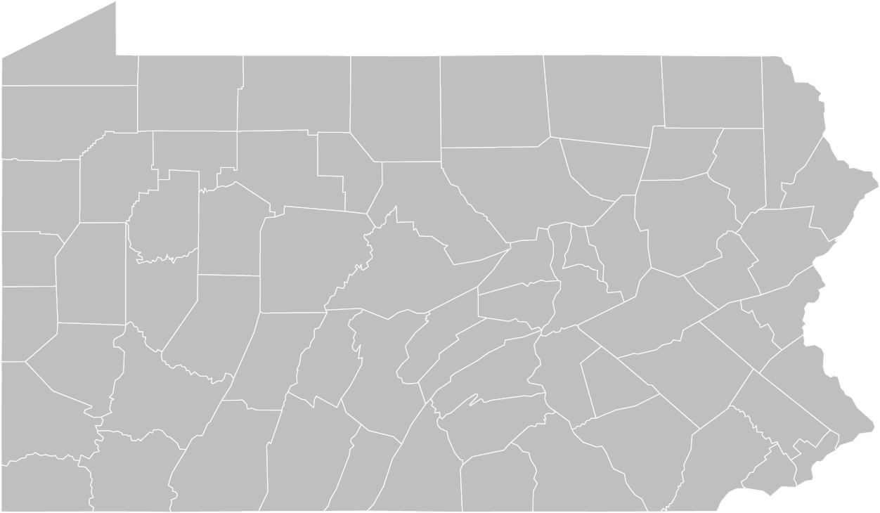



Community Engagement Across PA
24 Campuses
67 Extension Offices
21 LaunchBoxes
2 PSU Centers
2 OLLI Offices
2 Small Bus. Dev. Centers
Shaver’s Creek
Justice and
Safety Institute
WPSU-TV
WPSU-FM
Notes:
Note: this slide has a 7-click animation to make it easier to follow

Slide 22
Major Hubs of Community Engagement
Community engagement is integrated into our mission of teaching, research, and service, and it’s central to these areas:
Penn State Extension
Penn State Outreach
Industry Partnerships and Economic Development
Centers and Institutes
Student Engagement Network

Slide 23
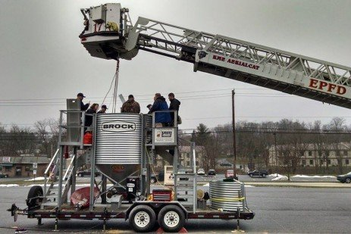
Extension Educators are Problem Solvers
Workshop/Conference registration: 50,000+/year.
Ag Progress Days attendance: 45,000/year.
4-H reaches more than 90,000 PA youth/year.
Master Gardeners and 4-H Extension have 10,000+ volunteers.
Extension Website: 9M users with 14M page
views annually (39K/day).
Farm emergency training provided by Penn State Extension is credited with saving a Pennsylvania farmer's life.

Slide 24
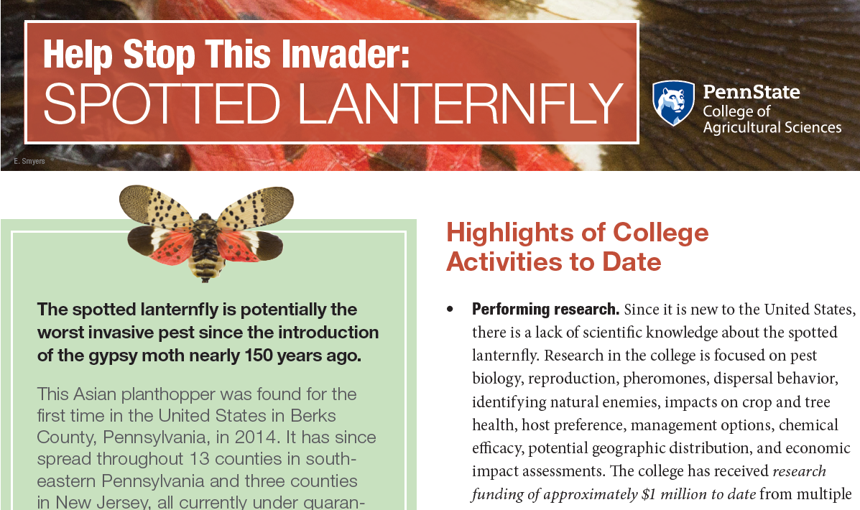
One Example: A Comprehensive Program to Protect the Ag Industry
PSU launched efforts prior to the awarding of state funding given the magnitude of the threat.

Slide 25
Spotted Lanternfly Extension Impact
Research: Received about $1M to date.
Building Awareness: Launched website working with PA Dept. of Ag (PDA) and USDA. Attracted 840,000+ page views since July 2018. Staffed public Hotline, which has logged 14,000+ calls.
Coordinating Outreach Activities: Held in-person informational meetings reaching 8,750+ participants.
Identification and Reporting: Providing online process to help the public identify and report sightings for action by PDA. Website visitors have reported 18,000+ sightings.
Developing Management Solutions: Distributed more than 300,000 educational products since June 2018.

Slide 26
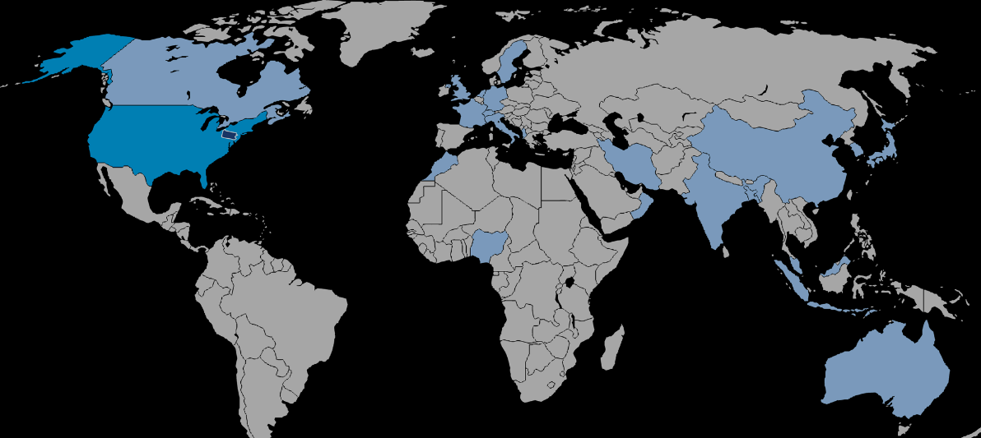
Penn State Outreach
Delivers compelling and evidence-based content developed by University faculty.
Reaches broad and diverse audiences through traditional and digital distribution channels.
Engages students in meaningful learning opportunities.
Reaches 67 Pennsylvania counties, 50 states and 21 countries.

Slide 27
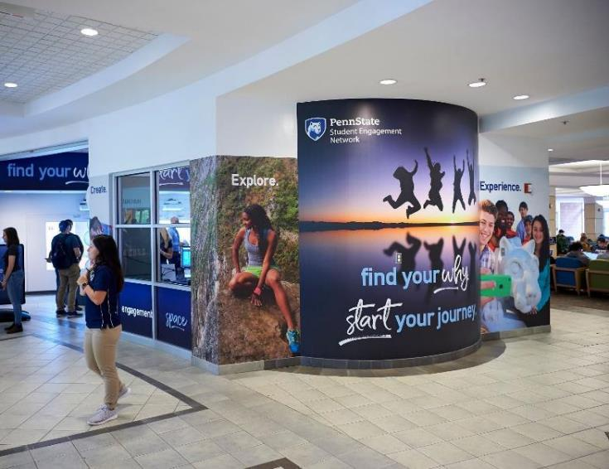
Student Engagement Network Impact
Grant Program: 500+ students awarded;
$600,000+ funded.
Internship Program: 22 students hired.
Faculty Academy: 8 faculty fellows;
2 faculty scholars.
Engagement Space: 2,500+ student visitors.
Portal will launch Dec. 2020.
PSU students collectively spend approx. 3.9M hours annually engaged in community service and volunteer activities.
Source: 2017 Student Experience Survey

Slide 28


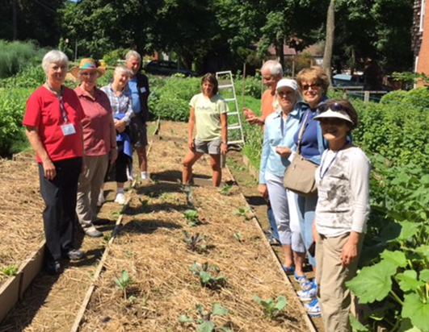
One Penn State 2025

Slide 29
Penn State as a Leader in the Transformation of Higher Education
Academic ranking, history as an online pioneer, brand strength, financial stability, technological capabilities and growth, efforts to tackle costs over the last decade – all yield a potential for innovation that few institutions are capable of accomplishing.

Slide 30

The Vision: One Penn State 2025
To be more integrated, flexible and responsive as an institution
Seamless online access to curricula and processes across all Penn State campuses
Function 24/7/365
Serving needs of people where they are
A higher level and strengthening of already-existing commitments
To be more diverse and inclusive

Slide 31
Guiding Principles
Provide a Seamless Student Experience
Achieve Curricular Coherence
Design Relevant and Responsive Programs
Engage Learners Throughout Their Lifetimes
Achieve the Highest Level of Efficiency of University Resources

Slide 32
Summary:
By living the land-grant mission through the Commonwealth Campuses, Research, Community Engagement, and One Penn State 2025, Penn State:
  Serves society
  Drives student opportunities and success
  Promotes economic development and progress
  Attracts leading faculty and outstanding students
  Enhances standing as a world-class institution

Slide 33
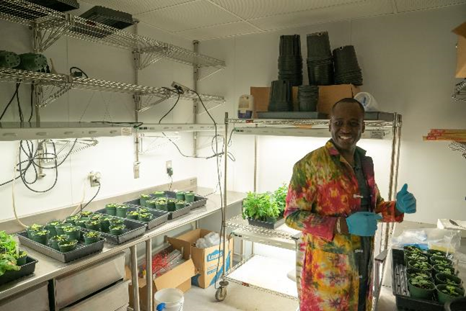
Thank you.
Questions?

