Slide 1
Welcome to Penn State’s
2019 New Faculty Orientation
Dr. Kathleen Bieschke
Vice Provost for Faculty Affairs
Tuesday, August 20, 2019
Office of the Vice provost for faculty affairs
Notes:
BIESCHKE– Slide 1: Welcome
Good morning and welcome to today’s orientation for new Penn State faculty.
My name is Kathy Bieschke, and I am the University’s Vice Provost for Faculty Affairs. I’ve been a Penn State faculty member since 1991 and I have been serving in this position for about two years.
I’m looking forward to our time together today. I hope it will provide you with the opportunity to learn what you need to know, and more about this institution.
In addition, I hope you will engage throughout the day with not only today’s speakers and presenters, but also with your fellow faculty who are new to Penn State. Today’s orientation is for those new to Penn State who are on the tenure line. We have many assistant professors in the room, as well as associate and full professors who have joined us from other institutions. And, we have faculty here from many of our campuses as well as several attendees joining us via zoom.
There is a lot to cover, and I suspect that even though I’ve worked at Penn State for nearly 30 years, I will learn new information right along with all of you. As you’ll soon recognize, Penn State is a large and complex university.
Thank you in advance for your time, attention, and participation today. Make the most of it!

Slide 2
Today’s Agenda
  Academic Freedom
  Student Affairs
  Research and Development
  Teaching and Learning
  Advising
  Promotion and Tenure
  Conversation with President Barron
Key Topics Include:
  Conversation with Provost Jones
  Affirmative Action
  Educational Equity
  Library Resources
  Shared Governance
  Mentoring
  IT
OFFICE OF THE VICE PROVOST FOR FACULTY AFFAIRS
Notes:
BIESCHKE – Slide 2: Today’s Agenda
This will be a busy day, as you can see from reviewing the two-sided agenda provided to you at your tables.
We will be covering a lot of important topics to ensure you are informed and engaged from day one – from Affirmative Action, Educational Equity, and Library Resources to Shared Governance, Research and Development, Academic Freedom, Mentoring, Teaching and Learning, Advising, IT, and Promotion and Tenure.
Penn State’s President, Dr. Eric Barron, also will join us later today to have a dialogue with all of you. And shortly you will hear from our Executive Vice President and Provost, Dr. Nick Jones.
But first, as we get started this morning, I’d like to share some information for context about our extraordinary faculty and how the Office of the Vice Provost for Faculty Affairs is set up to support you and your work at Penn State.

Slide 3
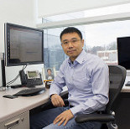
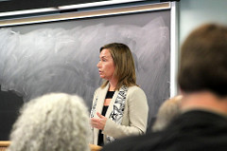
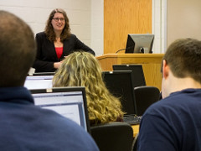
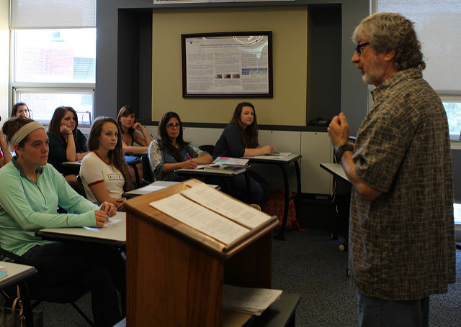
Faculty Facts – Who We Are
Fall 2018
  Full-Time Faculty: 7,076
  Part-Time Faculty: 1,889
  Total Faculty: 8,965
  Sources: University Budget
  Office / Penn State Factbook
OFFICE OF THE VICE PROVOST FOR FACULTY AFFAIRS
Notes:
BIESCHKE – Slide 3: Faculty Facts – Who We Are
As new Penn State faculty, you are joining an esteemed group. So, here’s a little information about this group of which you are all are now a vital part.
Who are our faculty, by the numbers?
For the most recent academic year that began in Fall 2018, across Penn State University, we had:
7,076 full-time faculty, and
1,889 part-time faculty …
… for a total of 8,965.

Slide 4
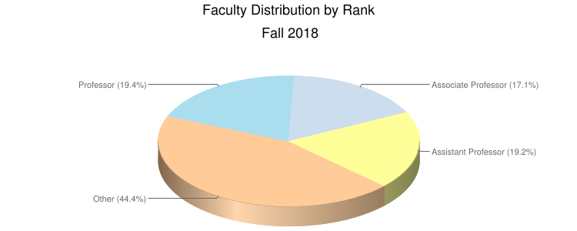
Faculty Facts – By Rank
  Sources: University Budget Office / Penn State Factbook
OFFICE OF THE VICE PROVOST FOR FACULTY AFFAIRS
Notes:
BIESCHKE – Slide 4: Faculty Facts – By Rank
Here are full-time faculty, by rank, as a percentage of the total:
As of Fall 2018, we had:
Professors: 19.4%
Associate Professors: 17.1%
Assistant Professors: 19.2%
Instructors: 7.7%
Other: 44.4% … The “Other” category includes instructors, lecturers, teaching faculty, research faculty, clinical faculty, and librarians.
Notes:
The percentages above exclude Penn College and Penn State Health.
For 2018, with the implementation of a new human resource information system, post-doctoral scholars and fellows were reclassified from part-time to full-time.

Slide 5
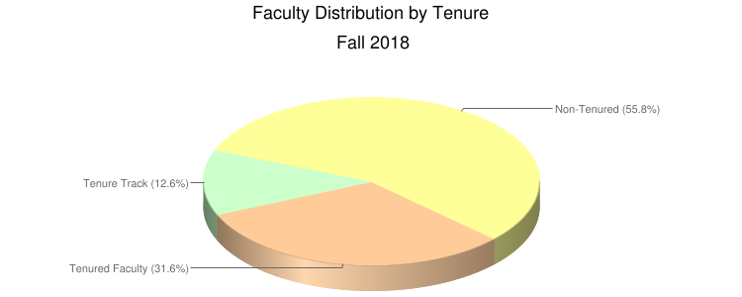
Faculty Facts – By Tenure Status
  Sources: University Budget Office / Penn State Factbook
OFFICE OF THE VICE PROVOST FOR FACULTY AFFAIRS
Notes:
BIESCHKE – Slide 5: Faculty Facts – By Tenure Status
Who are our full-time faculty, by tenure status?
As of Fall 2018, the numbers were:
Tenured: 31.6%
Tenure-Track: 12.6%
Non-tenured: 55.8%
Notes:
The percentages above exclude Penn College and Penn State Health.
For 2018, with the implementation of a new human resource information system, post-doctoral scholars and fellows were reclassified from part-time to full-time, and pre-doctoral fellows and trainees were reclassified from part-time academic to part-time student.

Slide 6
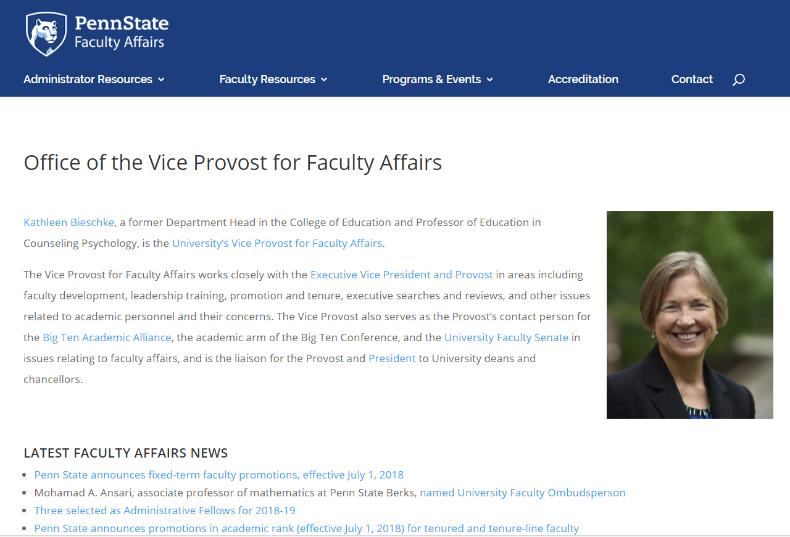

Full-Time Focus on Faculty Affairs
Office of the Vice Provost for Faculty Affairs
vpfa.psu.edu
OFFICE OF THE VICE PROVOST FOR FACULTY AFFAIRS
Notes:
BIESCHKE – Slide 6: Full-Time Focus on Faculty Affairs
So, what is the role of the Vice Provost for Faculty Affairs in supporting all Penn State faculty?
In a sentence: My position is dedicated to ensuring that all faculty at Penn State have every opportunity to be successful. It’s an ever-evolving role, with a full-time focus on faculty affairs.
Among other responsibilities, I work closely with Executive Vice President and Provost Nick Jones in areas including faculty development, leadership training, promotion and tenure, executive searches and reviews, and myriad issues related to academic personnel and their concerns.
I’d also like to introduce the staff in my office who are here today. Tineke Battle is the Assistant Vice Provost for Faculty Affairs and she works primarily in the area of human resources. Jenny Hamer is the Associate Vice Provost for Faculty Affairs and she primarily focuses on faculty development. Please feel free to ask us any questions you may have today.
I also have several administrative staff members here today: Mindy Kowalski, Karen Parkes-Schnure, and Wendy Blumenthal. Please feel free to ask them questions as well as they often know far more than we do.
You can learn more about me, my background, and the Office of the Vice Provost for Faculty Affairs online at vpfa.psu.edu.

Slide 7
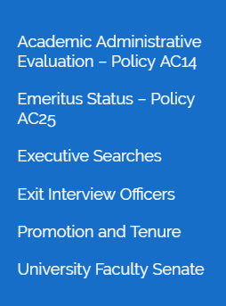
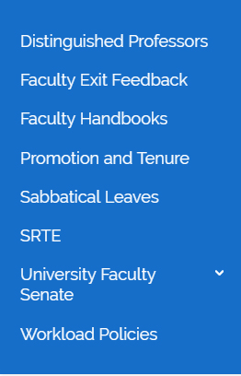
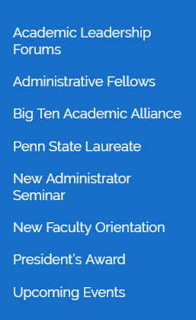
A Closer Look
Office of the Vice Provost for Faculty Affairs
vpfa.psu.edu
policy.psu.edu
OFFICE OF THE VICE PROVOST FOR FACULTY AFFAIRS
Notes:
BIESCHKE – Slide 7: A Closer Look
A closer look at the content on the VPFA website reveals the depth and breadth of the office’s work.
Here you’ll see three of the main sections of the website and the extensive drop-down menus with links to information on a variety of important topics, some of which we will be covering today.
Administrator Resources – includes links to important policy documents, as well as information about Promotion and Tenure and the University Faculty Senate, which you will learn more about later from Senate Chair Nicholas Rowland.
Faculty Resources – Here you’ll find more information about sabbatical leaves, SRTEs, and workload policies, among other topics. Always ask questions and consult specific University policies as needed for up-to-date information. You can find them at policy.psu.edu, and the Academic Policies section will be of particular interest to you.
Programs and Events – Many of our events our tailored toward supporting faculty as they pursue administrative roles. Note, however, that here is where you will find our New Faculty Orientation page, and this is where select materials from today’s event will be posted for your future reference.
The Bottom Line: The VPFA website is a great place to review material that all of you will consider relevant, in addition to and beyond everything we will cover today.

Slide 8
Let’s Get Started!
“Housekeeping” Notes:
  Scheduled breaks
  Questions and comments
  Lunch and Networking Time
vpfa.psu.edu
Our First Speaker: Dr. Nick Jones, Penn State Executive Vice President and Provost
OFFICE OF THE VICE PROVOST FOR FACULTY AFFAIRS
Notes:
BIESCHKE – Slide 8: Let’s Get Started!
So, with that information for context, we can get started!
A few housekeeping notes:
You’ll see we have 15-minute breaks scheduled at 9:45 a.m. and 2:15 p.m. Please make sure to return from those breaks on time so we can stay on schedule.
In conjunction with today’s presentations, there will be some opportunities to take your questions or comments. Please stand and use the microphones if you ask questions so everyone can hear them. This is especially important for our colleagues around the commonwealth who are joining us via zoom.
Our lunch and networking time are scheduled from noon to 1:00 p.m. We will be eating in The Gardens restaurant, which is on the first floor of the Penn Stater.
We’ll wrap up today from 4:00-5:00 p.m. with an ice cream social in Presidents Hall 4., where President Barron and Provost Jones will join us.
Now I’d like to introduce and welcome our first speaker and special guest: Dr. Nick Jones, Executive Vice President and Provost at Penn State.
Use prepared introduction of Nick here (provided separately).
Please join me in welcoming Dr. Jones. (lead applause)

